Slide 1
In the Beginning: The Intelligent Designer speaks
One God, One Man, One Mission
Excite Inform Challenge
Notes:
Link to intro movie – while ppl getting seated

Slide 2
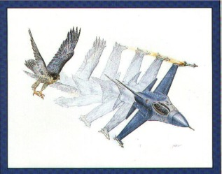
The Science of Intelligent design attempts to understand the evidence for intelligence in the natural world.
The fundamental claim:
There are natural systems that cannot be adequately explained in terms of undirected natural forces and that exhibit features which in any other circumstance we would attribute to intelligence.
Notes:
Link to expelled trailer

Slide 3
Intelligent design is the science that studies the signs of intelligence.
Intelligent Design is a strictly scientific theory devoid of religious or theological commitments
(- but it clearly has theological implications as does Darwinism).
The design hypothesis most clearly accounts for the evidence of science and most especially the evidence gathered over the last 30 years.
It has considerable "explanatory power".

Slide 4
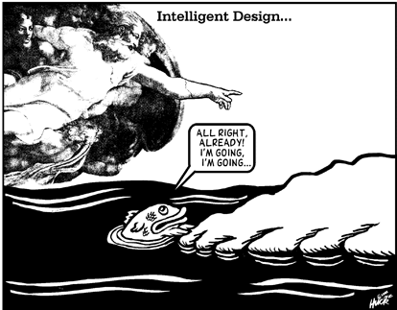
Intelligent design includes such fields as:
∙ Forensic Sciences,
∙ Cryptanalysis,
∙ Archaeology,
∙ Arson investigation,
∙ Copyright infringement and plagiarism,
∙ The Search for Extra-Terrestrial
Intelligence (SETI)

Slide 5
Any intelligence responsible for biological systems could not be an evolved intelligence but must exist prior to the systems for which it is responsible.
The controversy:
ID claims to discover signs of intelligence in biological systems for which the underlying intelligence is not, and indeed cannot be, an evolved intelligence.

Slide 6
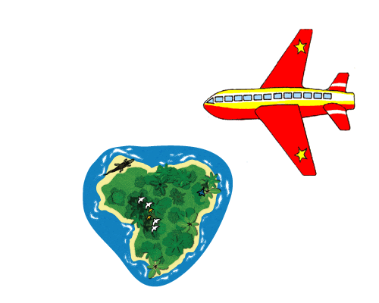
In considering whether ID is science there are three points that should be kept in mind:
Science is not decided by majority vote.
Just because an idea has religious, philosophical, or political implications does not make it unscientific.
To call some area of inquiry “not science” or “unscientific” or to label it “religion” or “myth” is within contemporary western culture a common maneuver for discrediting an idea.
Parable – Lost on a desert island!
Notes:
A pilot flying his plane over the South Pacific sees an uncharted island in the distance and circles downward to take a closer look. As the plane descends, the pilot spots large rocks on the island's shore arranged to spell out SOS. Beyond the reach of waves, he notices a grass hut. Without hesitation, the pilot radios for help.
Is this pilot behaving rationally? No one would question the point. He recognizes the improbability of wind and waves acting on the rocks along the shore to spell SOS. Experience has taught the pilot that intelligible messages must come from intelligent sources. SOS, though not a word in the English language, represents the code for the universal distress message. The island inhabitant spelled out not just a word, such as "help," but a special code, SOS, on the beach knowing that anyone seeing it from the air would recognize its meaning.
The grass hut also convinces the pilot to radio for help. It provides further evidence that the rocks' arrangement on the beach is not the effect of chance, but rather the work of someone stranded on the island. Encoded information coupled with additional evidence for intelligent activity provides support for design that goes beyond the mere presence of information. It requires an intelligent agent to choose and employ the code. And, encoded information carries an implied sense of purpose.

Slide 7
Scientists have discovered that the cell's biochemical machinery is an information-based system.
The chemical information inside the cell exists as encoded information.
The genetic code (the rules used to encode the cell's information) defines the cell's biochemical information system.
Evidence to date indicates that this genetic code originated at the time life first appeared on Earth.
Thus an Intelligent Designer is responsible for the genetic code.

Slide 8
Intelligent Design through the Scientific Method:
i. Observation:
When intelligent agents act, itis observed that they produce high levels of "complex-specified information" (CSI) or ‘specified complexity’.
Notes:
The Scientific Method: Generally, science tries to adhere to the following 4 step process to discover new ways of understanding. This 4 step process is: observe hypothesis expt conclude
Specified Complexity:
An event with is easy to define (and has a minimal description (eg getting 10 heads in a row) (called low specificational complexity) combined with being highly improbable (called high probabilistic complexity) is defined as having specified complexity.
An event has an extremely high probabilistic complexity is its probability is beyond the Universal Probability Bound’

Slide 9
Scientists estimate that within the known physical universe, there are around10 ⁸⁰ elementary particles.
Transitions from one physical state to another cannot occur at a rate faster than10 ⁴⁵ times per second.
Finally the universal itself is about a billion times younger than 10 ²⁵ seconds (assuming the universe is between 10 and 20 billion years old – best estimates now 13.7 B Yrs).
The total number of specified events throughout cosmic history cannot exceed
10 ⁸⁰ x 10 ⁴⁵ x 10 ¹⁵ = 10 ¹⁵⁰
Thus, any specified event of probability less than 1 in 10 ¹⁵⁰ is effectively impossible.
Notes:
By 2001 those odds had shrank to less than one in a number so large it might as well be infinity (10 173 ).

Slide 10
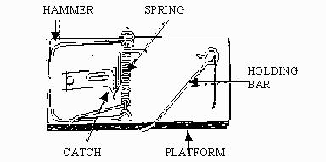
ii. Hypothesis:
If an object in the natural world was designed, then we should be able to examine that object and find the same high levels of CSI in the natural world as we find in human-designed objects.
iii. Experiment:
We can examine biological structures to test if high CSI exists.
These biological machines are
"irreducibly complex".

Slide 11
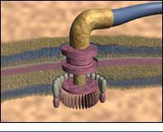
iv. Conclusion:
Because they exhibit high levels of CSI, a quality known to be produced only by intelligent design, and because there is no other known mechanism to explain the origin of these "irreducibly complex" biological structures, we conclude that they were intelligently designed.
Flagellum movie

Slide 12
Table 1. Ways Designers Act When Designing (Observations):
(1) Take many parts and arrange them in highly specified and complex patterns which perform a specific function. (2) Rapidly infuse any amounts of genetic information into the biosphere, including large amounts, such that at times rapid morphological or genetic changes could occur in populations. (3) 'Re-use parts' over-and-over in different types of organisms (design upon a common blueprint). (4) Be said to typically NOT create completely functionless objects or parts (although we may sometimes think something is functionless, but not realize its true function).

Slide 13
Table 2. Predictions of Design (Hypothesis):
High information content machine-like irreducibly complex structures will be found.
Forms will be found in the fossil record that appear suddenly and without any precursors.
Genes and functional parts will be re-used in different unrelated organisms.
The genetic code will NOT contain much discarded genetic baggage code or functionless "junk DNA".
Notes:
Consider now the following possibility: What if organisms instantiate designs that have no functional significance but that nonetheless give biological investigators insight into functional aspects of organisms. Such second-order designs would serve essentially as an “operating manual,” of no use to the organism as such but of use to scientists investigating the organism. Granted, this is a speculative possibility, but there are some preliminary results from the bioinformatics literature that bear it out in relation to the protein-folding problem (such second-order designs appear to be embedded not in a single genome but in a database of homologous genomes from related organisms). While it makes perfect sense for a designer to throw in an “operating manual” (much as automobile manufacturers include operating manuals with the cars they make), this possibility makes no sense for blind material mechanisms, which cannot anticipate scientific investigators

Slide 14
Table 3. Examining the Evidence (Experiment and Conclusion):
Line of Evidence | Data (Experiment) | Prediction of Design Met?
(1) Biochemical complexity / Laws of the Universe. | High information content machine-like irreducibly complex structures are commonly found. The bacterial flagellum is a prime example. Specified complexity found in the laws of the universe may be another. | Yes.
(2) Fossil Record | Biological complexity (i.e. new species) tend to appear in the fossil record suddenly and without any similar precursors. The Cambrian explosion is a prime example. | Yes.
(3) Distribution of Molecular and Morphological Characteristics | Similar parts found in different organisms. Many genes and functional parts not distributed in a manner predicted by ancestry, and are often found in clearly unrelated organisms. The "root" of the tree of life is a prime example. | Yes.
(4) DNA Biochemical and Biological Functionality | Increased knowledge of genetics has created a strong trend towards functionality for "junk-DNA." Examples include recently discovered functionality in some pseudogenes, microRNAs, introns, LINE and ALU elements. Examples of DNA of unknown function persist, but discovery of function may be expected (or lack of current function still explainable under a design paradigm). | Yes.

Slide 15
Predictions:
Darwinian evolution makes very few predictions and to date few appear verified. This is particularly noticeable when compared with say Newton’s Laws of Planetary Motion which made predictions which have been well verified.
ID’s main prediction is that nature if overflowing with examples of specified complexity and therefore there are numerous pointers to design.
ID also predicts certain patterns such as:
Sudden emergence
Convergence to local optima
Extinction

Slide 16
The Anthropic Principle:
Brandon Carter, (British mathematician) - 1973-74
It states that the universe appears "designed" for the sake of human life.
To state the principle more dramatically, a preponderance of physical evidence points to humanity as the central theme of the cosmos.
Notes:
In 1961, astronomers acknowledged just two characteristics of the universe as "fine-tuned" to make physical life possible.
Today, the number of known cosmic characteristics recognized as fine- tuned for life—any conceivable kind of physical life—stands at around 38!

Slide 17
Sir Fred Hoyle
`A commonsense interpretation of the facts suggests that a super-intellect has monkeyed with physics, as well as chemistry and biology, and that there are no blind forces worth speaking about”
Physicist Paul Davies,
`The impression of design is overwhelming. The Big Bang appears to have been fine-tuned for the existence of intelligent life with a complexity and precision that literally defies human comprehension“
Stephen Hawking:
`Almost everyone now believes that the universe, and time itself, had a beginning.’ It would be very difficult to explain why the universe should have begun in just this way, except as the act of a God who intended to create beings like us.“

Slide 18
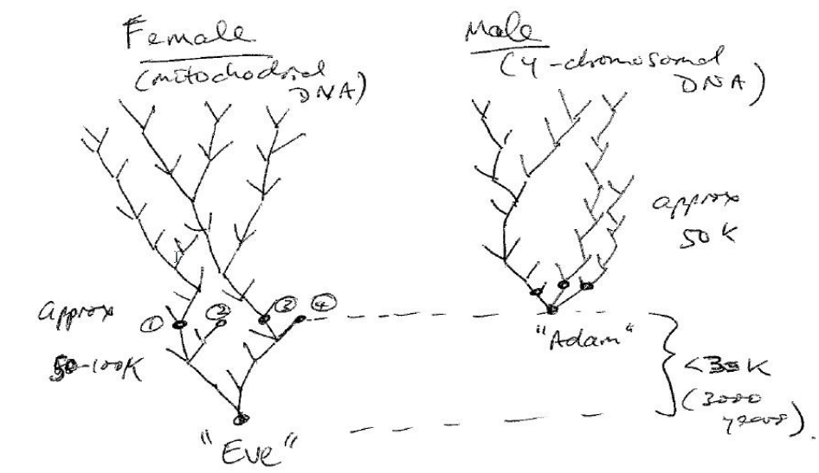
The beginning of the Human race:
Science predicts a single couple; at a single location & relatively recent beginning for mankind.
Who may this have been?
mitochrondrial Eve & y-Chromosomal Adam; support re location & time scale (< 100k yrs)

Slide 19
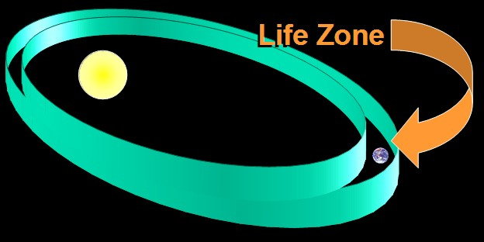
Our Sun – an example of fine-tuning – size, age, stable orbit, …

Slide 20
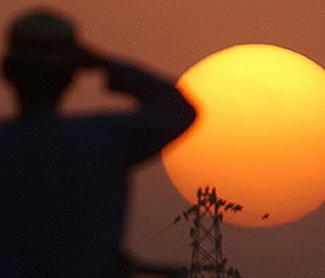
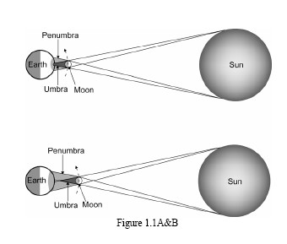
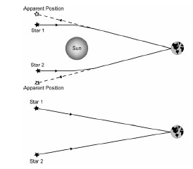
Our Moon
Notes:
a total eclipse of the sun, where the moon just barely covers the sun's pho­tosphere.
as soon as the total phase of the eclipse ended, when you could see the sun's beautiful corona and it was relatively dark, people spontaneously applauded as if rewarding a show. It was just so beautiful?“
eclipses are better viewed on Earth than they would be from any other planet in our solar system.
In fact, of the nine plan­ets with their more than sixty-three moons in our solar system, the Earth's surface is the best place where observers can witness a total solar eclipse, and that's only possible for the `near-term' future.¹²
"What's really amazing is that total eclipses are possible because the sun is four hundred times larger than the moon, but it's also four hundred times further away. It's that incredible coincidence that cre­ates a perfect match.
"Second, a perfect solar eclipse in 1919 helped two teams of astronomers confirm the fact that gravity bends light, which was a pre­diction of Einstein's general theory of relativity. That test was only possible during a total solar eclipse, and it led to general acceptance of Einstein's theory.
"Third, perfect eclipses provided a historical record that has, enabled astronomers to calculate the change in the Earth's rotation over the past several thousand years. This enabled us to put ancient
calendars on our modern calendar system, which was very significant." Richards, who had been listening intently, spoke up. "What's, mysterious," he said, "is that the same conditions that give us a hab­itable planet also make our location so wonderful for scientific meas­urement and discovery. So we say there's a correlation between habitability and measurability⁻.
"Not only does the specific configuration of the Earth, sun, and moon allow for perfect eclipses, but that same configuration is alsc vital to sustaining life on Earth.
how the size and location of the moon stabilizes our tilt and increases our tides and how the size of the sun and our distance from it also make life possible here.

Slide 21
Some Predictions Made by the Naturalistic (Evolutionary) Origin-of-life Scenario
Chemical evidence for the pre-biotic soup will be found in the geological record.
Placid chemical and physical conditions existed on the early earth for long periods of time.
Chemical pathways leading to the formation of biomolecules will be found.
Chemical pathways that produce biomolecules would have been capable of operating under the conditions of the early earth.
Life emerged gradually over a long period of time.
Life originated only once.
Life in its minimal form is simple.

Slide 22
Table II Some Predictions Made by the Biblical Origin-of-life Scenario
Life appeared early in Earth’s history.
Life appeared under harsh conditions.
Life miraculously persisted under harsh conditions.
Life arose quickly.
Life in its minimal form is complex.
The Amazing Majesty and Awesomeness
of God’s creation

Slide 23
Successionism

Slide 24
Bishop Ussher’s mistakes:
Matthew 1:8 lists King Joram as the father of King Uzziah, but the TaNaK (OT) tells as that Joram was the great-great-grandfather of Uzziah.
Also Ezra 7:1-5 traces Ezra’s line back about a thousand years to Aaron but only lists 16 generations.
Luke 3:35-36 tells us that Arphaxad was the grandfather of Shelah but in Genesis 11 Arphaxad is listed as the father of Shelah.
Notes:
Clearly the Hebrews did not attempt to keep a complete list of ancestors and thus there is no way we can use this information to date Adam and Noah.

Slide 25
The genealogy of Moses:
Exodus 6:16-20, Numbers 26:57-59;
1 Chronicles 6:1-3; 1 Chronicles 23:6, 12-13
In these passages, his genealogy is given as Levi (the patriarch) to Kohath to Amram (and his wife Jochebed) to Moses.
As straightforward as this seems, we can use other Bible passages to demonstrate that at least six names were likely skipped between Amram and Moses

Slide 26
Ex 6:16-20 (ESV)
¹⁶ These are the names of the sons of Levi according to their generations: Gershon, Kohath, and Merari, the years of the life of Levi being 137 years. ¹⁷ The sons of Gershon: Libni and Shimei, by their clans. ¹⁸ The sons of Kohath: Amram, Izhar, Hebron, and Uzziel, the years of the life of Kohath being 133 years. ¹⁹ The sons of Merari: Mahli and Mushi. These are the clans of the Levites according to their generations. ²⁰ Amram took as his wife Jochebed his father's sister, and she bore him Aaron and Moses, the years of the life of Amram being 137 years.

Slide 27
Num 26:57-59 (ESV)
This was the list of the Levites according to their clans: of Gershon, the clan of the Gershonites; of Kohath, the clan of the Kohathites; of Merari, the clan of the Merarites. ⁵⁸ These are the clans of Levi: the clan of the Libnites, the clan of the Hebronites, the clan of the Mahlites, the clan of the Mushites, the clan of the Korahites. And Kohath was the father of Amram. ⁵⁹ The name of Amram's wife was Jochebed the daughter of Levi, who was born to Levi in Egypt. And she bore to Amram Aaron and Moses and Miriam their sister

Slide 28
1 Chron 6:1-3 (ESV)
¹ The sons of Levi: Gershon, Kohath, and Merari. ² The sons of Kohath: Amram, Izhar, Hebron, and Uzziel. ³ The children of Amram: Aaron, Moses, and Miriam.
And yet Ex 2 does not mention the names of Moses parents:
Now a man from the house of Levi went and took as his wife a Levite woman. Ex 2:1 (ESV)

Slide 29
Kohath was born before the Israelites entered Egypt (Gen. 46:5-27; Exod. 1:1-4).
The exodus out of Egypt took place 430 years later (Exod. 12:40-41; Acts 7:6).
Since Moses was 80 years old at the time of the exodus, that means that from Kohath to Amram to Moses spanned at least 350 years.
Jochebed, Amram's wife, is described as a daughter of Levi (Num. 26:59) and as Amram's father's sister (Exod. 6:20). This means that she would have been born along with Kohath some 350 years before Moses!

Slide 30
The descendents of Kohath at the time of Moses numbered 8,600 mean (Num. 3:27-28) of which 2,750 were between the ages of 30 and 50 (Num. 4:30).
Moses is not listed among the descendents of Amram (1 Chron. 24:20).
There were 12 generations connecting the patriarch Ephraim to Joshua, son of Nun.

Slide 31
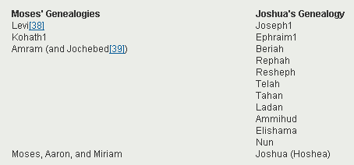
Joshua, son of Nun, was also a part of the exodus and has his own genealogy (Numbers 13:8, 16; 1 Chronicles 7:20-27).
Both sets of genealogies span the same 430-year period (Exodus 12:40-41; Acts 7:6) from the sojourn to Egypt till the exodus from Egypt, yet one lists 4 generations and the other has 12.

Slide 32
In 1 Chronicles 26:24 we read in a list of appointments made by King David (see 1 Chron. 24:3; 25:1; 26:26), that Shebuel the son of Gershom, the son of Moses, was ruler of the treasures; and again in 1 Chronicles 23:15, 16, we find it written, "The sons of Moses were Gershom and Eliezer. Of the sons of Gershom Shebuel was the chief."
Now it is absurd to suppose that the author of Chronicles was so grossly ignorant as to suppose that the grandson of Moses could be living in the reign of David (approx. a 500 yr gap), and appointed by him to a responsible office.
Notes:
Moses 1500 BC & David 1000 BC?

Slide 33
Again, in the same connection (1 Chron. 26:31), we read that "among the Hebronites was Jerijah the chief;" and this Jerijah, or Jeriah (for the names are identical), was, according to 23:19, the first of the sons of Hebron, and Hebron was (v. 12) the son of Kohath, the son of Levi (v. 6).
So that if no contraction in the genealogical lists is allowed, we have the great-grandson of Levi holding a prominent office in the reign of David
3 generations spanning over 900 years

Slide 34
Another Problem:
Genesis 1:4,5
Day used for 12 hours and 24 then in Gen 2:4 used for all of creation.
And God saw the light, that it was good; and God divided the light from the darkness. God called the light Day, and the darkness He called Night. So the evening and the morning were the first day.
This is the history of the heavens and the earth when they were created, in the day that the Lord God made the earth and the heavens

Slide 35
Young Earth Creationists use Ex 20:9-11 to suggest a parallel yet in 1 John 3:16
Six days you shall labor and do all your work, but the seventh day is the Sabbath of the Lord your God….. For in six days the Lord made the heavens and the earth, the sea, and all that is in them, and rested the seventh day. Therefore the Lord blessed the Sabbath day and hallowed it.
By this we know love, that he laid down his life for us; and we ought to lay down our lives for the brethren.
1st laying down and 2nd are not the same – the greater forms a pattern for the lessor – similarly with creation and Israel’s weekly calendar.

Slide 36
Also look at how much more happened on the 6th day:
after a long procession of animals,
no helper for Adam, Adam was lonely
he was put to sleep and Eve created, …
Gen 2:23
…at last … - meaning now, at length
– Adam had been waiting a long time.

Slide 37
Days of Divine Fiat:
1902 F H Capron
The 6 days are days when God issued his creative commands or fiats.
By the word of the LORD the heavens were made, and all their host by the breath of his mouth.
For he spoke, and it came to be;
he commanded, and it stood forth. (Psalm 33.6, 9.)
He commanded and they were created. (Psalm 148.5.)
By faith we understand that the world was created by the word of God. (Hebrews 11.3.)
By the word of God heavens existed long ago, and an earth formed out of water. (2 Peter 3.5.)
Notes:
If we are not careful we can easily overlook the importance God's fiats.
Scripture warns us not to do this.
In at least four different places, Bible writers remind us that creation took place because God commanded it.

Slide 38
We must not confuse these fiats of God with fiats uttered by a human ruler.
In accordance with this principle, Paul was able to say that God 'chose us in him before the foundation of the world’ (Eph 1.4), even though, in literal fact, we did not then exist.
Notes:
The latter may be accomplished but God's pronouncements always come to pass. When he promises something, the deed is as good as done.
Consequently, God can (and sometimes does) speak of his future plans as if they were already accomplished.

Slide 39
In similar vein, Revelation 13.8 speaks of our names being 'written the foundation of the world'.
Again, God told the prophet Jeremiah, 'Before I formed you in the womb I knew you, and before I formed you in the womb I knew you, and before you were born I consecrated you.' (Jeremiah 1.5.)
Notes:
Thus we must not think of the great fiats of Genesis I as if they were mere statements.
The future is as real to God as is the past to us. To him, those fiats were as actual as the creative actions which followed.
The fiats are the most vital part of Genesis I, for the creative acts and processes themselves were only the outcome of those fiats: they were absolutely bound to follow.

Slide 40
It appears that from God's point of view, which is very different from ours, creation was virtually completed as soon as he had uttered his infallible fiats.
The importance of this profound fact cannot be overemphasized.

Slide 41
Parenthesis in Scripture:
Another fact that impinges on our understanding of Genesis I is this: the writers of the Bible were much given to the use of parentheses.
That is to say, they would often insert a secondary thought into the middle of their primary message. Here is an example from the New Testament:
In those days Peter stood up among the brethren (the company of persons was in all about a hundred and twenty), and said, 'Brethren …' (Acts 1.15.)
Observe how the main sentence makes perfect sense if we read it on its own, ignoring the bit in brackets. Afterwards we can usefully go back and read the words in the brackets, as a separate but related thought.
Notes:
because we usually enclose it in a pair of brackets, or dashes, etc.
But punctuation marks were not invented in Bible times, and so there are no brackets, dashes or commas in the Greek and Hebrew manuscripts to guide our translators. They have to rely upon the sense of the words to show them where parentheses occur.
And it is evident that they do occur very frequently in the Bible.
The translators of our King James Version, though very anti-semitic, and were at least well aware of this.

Slide 42
As Bullinger said of the first edition of the KJV:
“The Edition of 1611 abounded in parentheses. In the subsequent editions there has been an increasing tendency to discard them; and to supply their place by commas; or to ignore them altogether.”
The fact remains that in the original text of the Bible there are a great many parentheses. Some of them are marked as such in Modern translations, others are not. And they go right back to the creation narrative.

Slide 43
The earliest one marked in the RSV is in Genesis , where a pair of dashes encloses a lengthy parenthesis:
In the day that the LORD God made the earth and the heavens, when no plant of the field was yet in the earth and no herb of the field had yet sprung up -for the LORD God had not caused it to rain upon the earth, and there was no man to till the ground; but a mist went up from the earth and watered the whole face of the ground -then the LORD God formed man of dust from the ground, and breathed into his nostrils the breath of life; and man became a living being. (Genesis 2.4-7)

Slide 44
The NIV also has a parenthesis in Genesis 2:
A river watering the garden flowed from Eden, and from there it divided; it had four headstreams. The name of the first is the Pishon; it winds through the entire land of Havilah, where there is gold. (The gold of that land is good; aromatic resin and onyx are also there.) The name of the second river is the Gihon; it winds through the entire land of Cush. (Genesis 2.10-13.)

Slide 45
Genesis 1 Repunctuated:
In the beginning God created the heavens and the earth. (Genesis 1.1.)
The next verse tells us to imagine the curtain rising on an already created planet, but a shapeless and empty one. God’s spirit is about to start fashioning it and then populating it:
The earth was without form, and void; and darkness was on the face of the deep. And the Spirit of God was hovering over the face of the waters. (Genesis 1.2)
Notes:
We have now noted two important facts about the Bible: the absolute reality of God's fiats; and the fondness of the Biblical writers for inserting parentheses. With these two points in mind, we can now consider the nature of Genesis I.
The very first verse evidently summarizes the early stages of creation. If it were not for the majesty of its contents, it might be likened to the little note headed, 'The Story So Far', which a magazine editor uses to introduce the latest instalment of a serial.

Slide 46
A repunctuated version of the whole passage up to Genesis 2.3, with the parentheses printed in italics.
And God said, 'Let there be light.' (And there was light. And God saw that the light was good; and God separated the light from the darkness. God called the light Day, and the darkness he called Night.)
And there was evening and there was morning, one day.
And God said, 'Let there be a firmament in the midst of the waters, and let it separate the waters from the waters.'
(And God made the firmament and separated the waters which were under the firmament from the waters which were above the firmament. And it was so. And God called the firmament Heaven.)
And there was evening and there was morning, a second day.
Notes:
At this point God begins to speak. According to the Fiat theory, the rest of the chapter is basically an account of the great creative fiats, which were uttered upon six (presumably literal and consecutive) days.
Inserted into the primary narrative is a whole series of parentheses, which describe the subsequent fulfilment of the fiats.
The out-workings of the fiats could have taken any amount of time to occur. The fiats of God are uttered swiftly, but his mills grind slowly.

Slide 47
And God said, 'Let the waters under the heavens be gathered together into one place, and let the dry land appear.'
(And it was so. God called the dry land Earth, and the waters that were gathered together he called Seas. And God saw that it was good. )
And God said, 'Let the earth put forth vegetation, plants yielding seed, and fruit trees bearing fruit in which is their seed, each according to its kind, upon the earth.'
(And it was so. The earth brought forth vegetation, plants yielding seed according to their own kinds, and trees bearing fruit in which is their seed, each according to its kind. And God saw that it was good.)
And there was evening and there was morning, a third day.

Slide 48
And God said, 'Let there be lights in the firmament of the heavens to separate the day from the night; and let them be for signs and for seasons and for days and years, and let them be lights in the firmament of the heavens to give light upon the earth.'
(And it was so. And God made the two great lights, the greater light to rule the day, and the lesser light to rule the night; he made the stars also. And God set them in the firmament of the heavens to give light upon the earth, to rule over the day and over the night, and to separate the light from the darkness. And God saw that it was good.)
And there was evening and there was morning, a fourth day.

Slide 49
And God said, 'Let the waters bring forth swarms of living creatures, and let birds fly above the earth across the firmament of the heavens.'
(So God created the great sea monsters and every living creature that moves, with which the waters swarm, according to their kinds, and every winged bird according to its kind. And God saw that it was good. And God blessed them, saying, “Be fruitful and multiply, and fill the waters in the seas, and let birds multiply on the earth.”)
So the evening and the morning were the fifth day.
Then God said, “Let the earth bring forth the living creature according to its kind: cattle and creeping thing and beast of the earth, each according to its kind”;
(and it was so. And God made the beast of the earth according to its kind, cattle according to its kind, and everything that creeps on the earth according to its kind. And God saw that it was good.)

Slide 50
Then God said, 'Let us make man in our image, after our likeness; and let them have dominion over the fish of the sea, and over the birds of the air, and over the cattle, and over all the earth, and over every creeping thing that creeps upon the earth,'
(So God created man in his own image, in the image of God he created him; male and female he created them, And God blessed them, and God said to them, ' Be fruitful and multiply, and fill the earth and subdue it; and have dominion over the fish of the sea and over the birds of the air and over every living thing that moves upon the earth.' And God said, ' Behold, I have given you every plant yielding seed which is upon the face of all the earth, and every tree with seed in its fruit,' you shall have them for food. And to every beast of the earth, and to every bird of the air, and to everything that creeps on the earth, everything that has the breath of life, I have given every green plant for food,' And it was so. And God saw everything that he had made, and behold, it was very good.)
An there was evening and there was morning, a sixth day.

Slide 51
Thus the heavens and the earth were finished, and all the host of them. And on the seventh day God finished his work which he had done, and he rested on the seventh day from all his work which he had done. So God blessed the seventh day and hallowed it, because on it God rested from all his work which he had done in creation. (Genesis 1.3 -2.3.)

Slide 52
Who were the Fiats uttered to:
Perhaps the angels – Job 38: 4-7
“Where were you when I laid the foundations of the earth?
Tell Me, if you have understanding.
Who determined its measurements?
Surely you know!
Or who stretched the line upon it?
To what were its foundations fastened?
Or who laid its cornerstone,
When the morning stars sang together,
And all the sons of God shouted for joy?
Notes:
Sean’s excellent Podacast on Gen 1:26

Slide 53
Some Advantages of this Theory:
Consistent with the two Biblical principles of foreordaining and parenthesis
Can be viewed as consecutive literal days – establishes the ‘divine ‘ week’ pattern for Israel
Poetic format –Hebrew poetry intended to be spoken/sung out loud – consistent with God speaking his fiats out loud and in poetic form:
Day 1 Light appears
Day 2 Waters are divided
Day 3 Land appears, with vegetation
Day 4 Lights appear
Day 5 Waters bring forth living creatures,
Day 6 Land is populated
[Utilises Hebrew method of parallelism – repetition at measured intervals]

Slide 54
Concluding Remarks:
Yahweh has revealed himself through Nature, the Resurrection and the Holy Scriptures
Intelligent Design is bringing more and more proof from the Natural World for God
Scientists, especially physicists are increasing acknowledging that there must be an Intelligent Designer
Even leading atheists such as Anthony Flew coming to faith because of ID
The Bible’s great many creation accounts do support an ancient earth and universe
True science and true religion will ultimately agree
Increasingly, there is little excuse to deny God and to deny the God of Abraham, Isaac & Jacob

Slide 55
Practical Applications:
Open your eyes to Nature – it screams of our God – He reveals His emotions through His creation;
Take time to learn about ID so you can defend your faith in this scientific and rational world*
Do some study of both Ancient Creationism and the myriad creation accounts in the Bible
Study the physics of the various dating techniques – they are, under the right conditions and restraints extremely reliable.
Your God is NOT a deceiver* – trust Him!
Notes:
Judaism considered the most rationale religion!
Apparent age

Slide 56
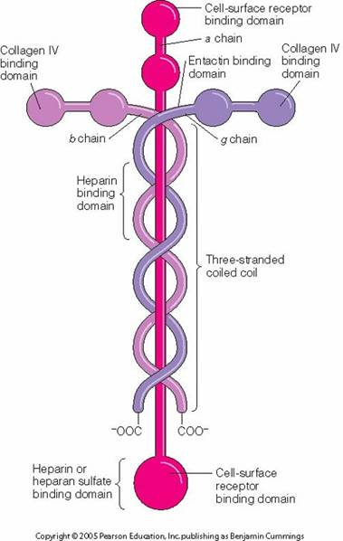
Laminin
A family of glycoproteins that are an integral part of the structural scaffolding in almost every animal tissue.
Laminin is vital to making sure overall body structures hold together.
Notes:
Laminin They are a family of glycoproteins that are an integral part of the structural scaffolding in almost every animal tissue.
Laminin is vital to making sure overall body structures hold together.

